Slide 1

Crossboard Application Authors: Luís Reis 48318 Rúben Louro 48926 Advisor: Pedro Pereira
Instituto Superior de Engenharia de Lisboa

Slide 2
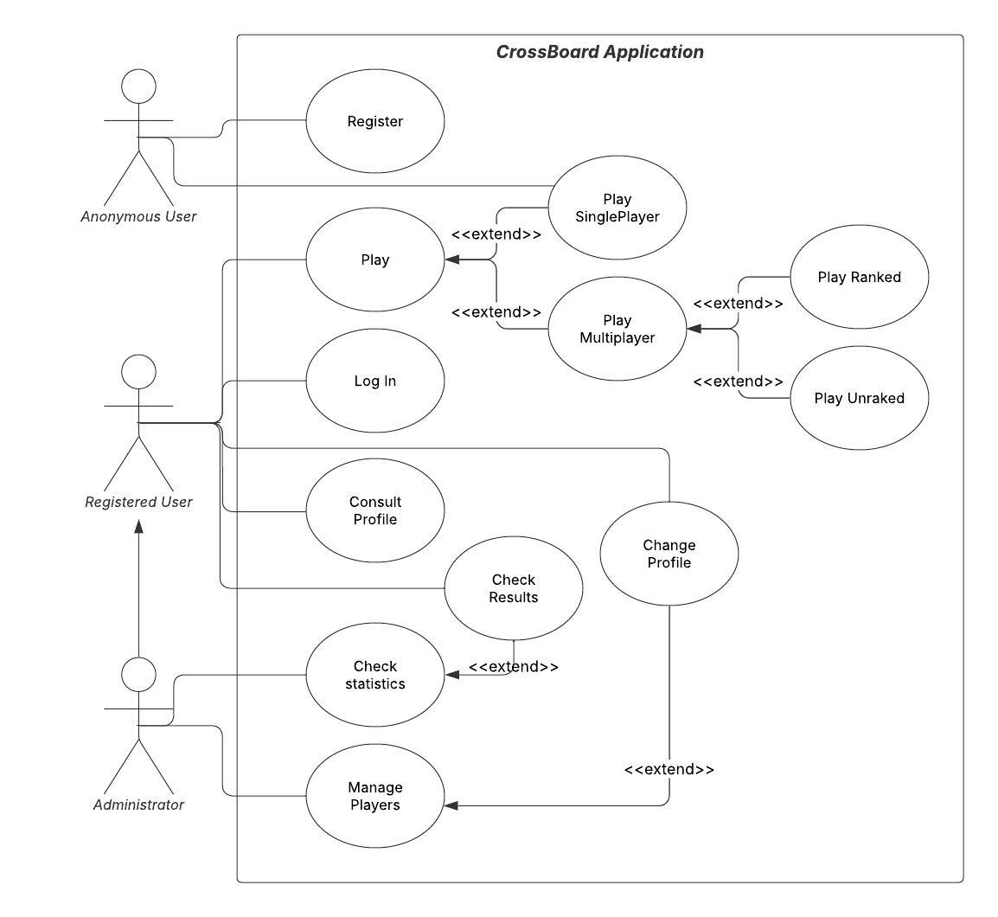
Crossboard Application UML Use Case

Slide 3
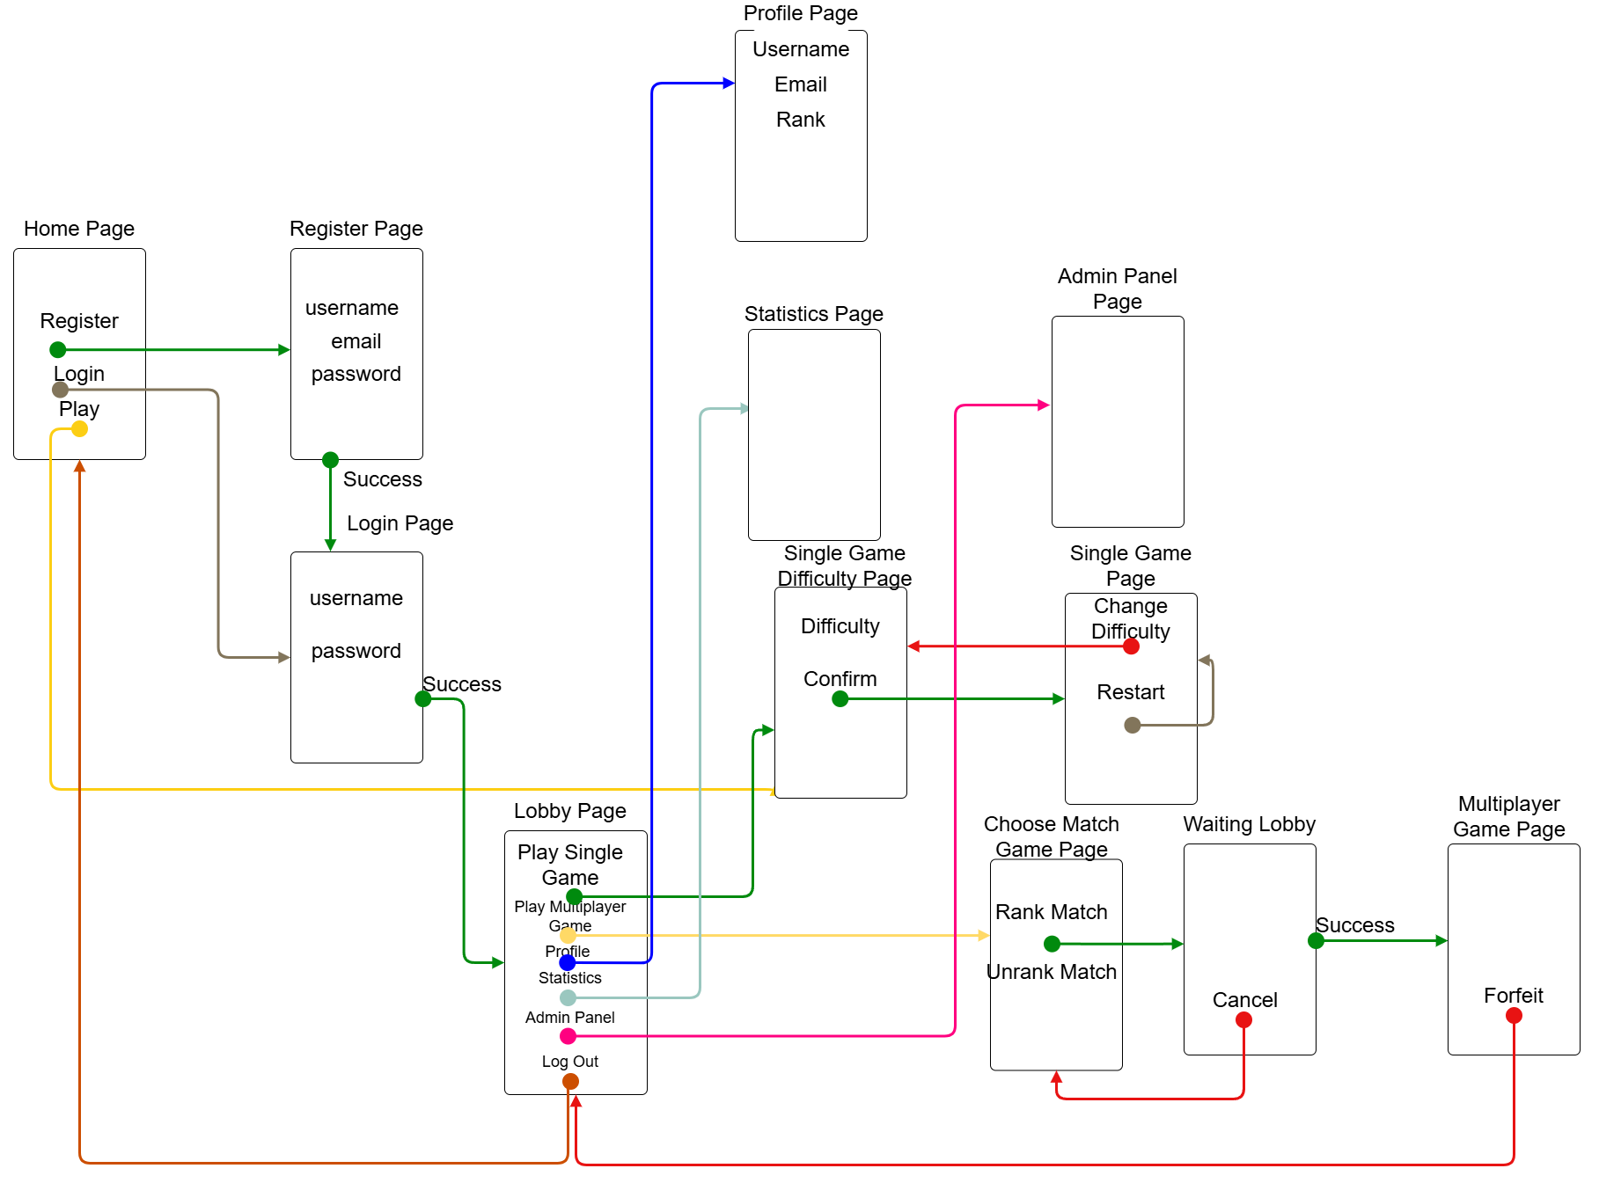
Crossboard Application Screen Flow

Slide 4
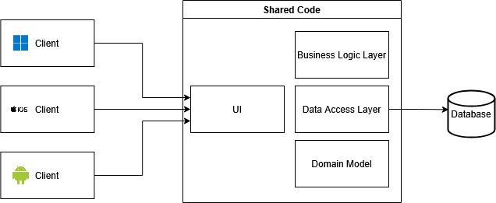
Crossboard Application System Architecture

